Slide 1




Information Extraction from German Medieval Charters Abstracts
Sandy Aoun, Varvara Arzt, Daniel Luger, Georg Vogeler

Slide 2
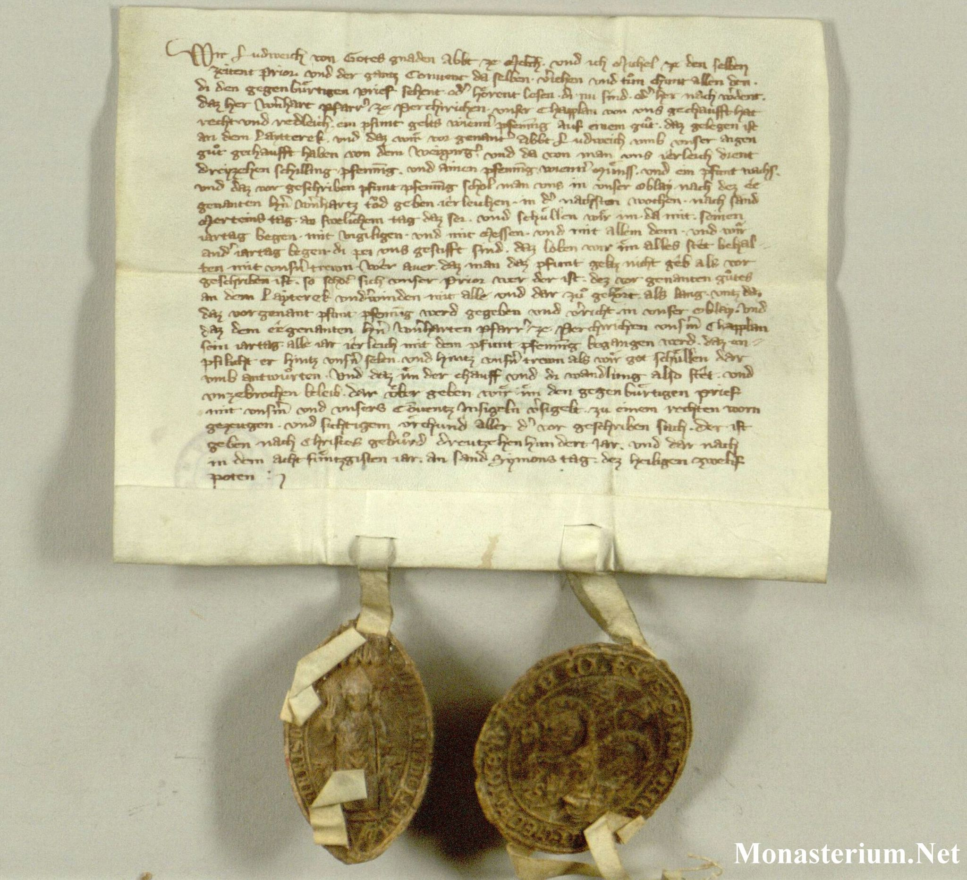
Diplomatics Research of Late Medieval Charters
Historical Charters:
Documents that record and formally express
a legally enforceable act
Reflect the evolving relationships between rulers
and subjects, as well as between different
social and economic groups
Crucial to understanding the development of
legal and political systems throughout history

Slide 3
Diplomatics Research of Late Medieval Charters
Diplomatics:
Auxiliary sciences of history scholarly field
Concerned with carrying in-depth critical analysis of historical documents
Understanding documentary practices:
Conventional visual features
Writing protocols and used textual patterns/formulae
Applications:
Determining the authenticity of charters
Relating the information which the charters present to previously known facts

Slide 4
Diplomatics Research of Late Medieval Charters
Traditional Diplomatics focuses on a limited number of charters at a time:
Individual chanceries
Collections of single institutions
Practices of one country or region
Surge in documentation of legal activity
during the late medieval period
Monasterium.net Platform [1]
Period | Nbr of charters
Before 1300 | 66,156
14th century | 156,098
15th century | 164,376
16th century | 81,751
17th century | 56,271
Not Dated | 132,898

Slide 5
Diplomatics Research of Late Medieval Charters
Need for ‘Digital Diplomatics’:
Making use of the large amount of digitized historical records
Incorporating digital methods into traditional diplomatics methodologies
Harnessing digital technologies to:
Enable the study of large amounts of charters produced in different regions and/or institutions
Open up the possibility of capturing a larger perspective on documentary practices

Slide 6
Information Extraction from Late Medieval Charters
Information Extraction:
Facilitates the semantic analysis of text
Allows for automatic exploration and querying of massive datasets in a short period
First relevant step: Named Entity Recognition (NER)

Slide 7
NER of Medieval Charters
Several studies: Aguilar et al., 2016; Chastang et al., 2021; Aguilar et al., 2021; Aguilar 2022; Monroc et al., 2022
Testing the applicability of contemporary NER techniques to few medieval languages:
Feature-based Machine Learning methods vs. Deep Learning-based methods
Restrictive set of annotated corpora to train and evaluate models (shared among multiple studies):
High-quality manually compiled datasets
Doesn’t account for the realistic case of noisy data due to HTR errors (Boroş et al., 2020)

Slide 8
Proposal: Investigate NER of Charters Abstracts
Charter Abstract:
Brief summary of a charter legal content
Written by expert historian in more modern language
Advantages:
More available in digital archives than charters images
Contain important ‘diplomatics search relevant’ entities

Slide 9
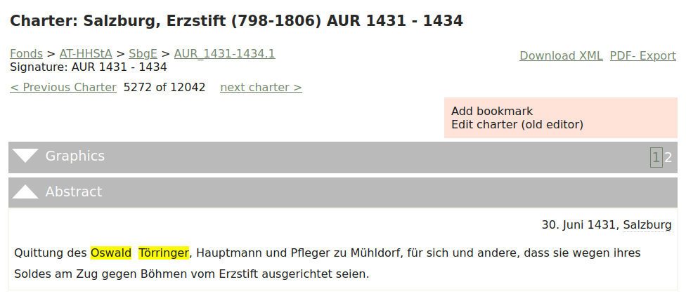
“Receipt from Oswald Törringer, captain and caretaker of Mühldorf, for himself and others, that they received their pay for working on the campaign against Bohemia from the archbishopric.”

Slide 10
NER of Charters Abstracts
Abstract:
“Christian Lanthaler (Länthaler), Bürger zu St. Veit im Pongau, verkauft seine Behausung und Hofstatt zu St. Veit dem Leonhard Ratzenberger.”
EN Translation:
“Christian Lanthaler (Länthaler), citizen of St. Veit im Pongau, sells his house and farmstead in St. Veit to Leonhard Ratzenberger.”
Abstract could:
Include quote from text of original charter
Be written in slightly outdated language form

Slide 11
Experiment
Starting Point:
How well could an open-source Standard German NER system function in this setting?
Experiment:
Evaluate the performance of a pre-trained Standard German model against that of a custom-made NER model

Slide 12
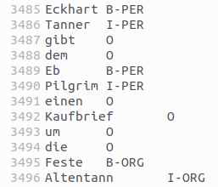
Building Ground-Truth Dataset
Ground-Truth Dataset:
2394 German abstracts of 138675 tokens (randomly selected)
From archive of the Archbishopric of Salzburg [2] and Melk Abbey records [3]
Tagged NE types: person, place, and organization names
Tagging scheme: BIO format
Partitions: 70% training set, 15% validation set, 15% testing set

Slide 13
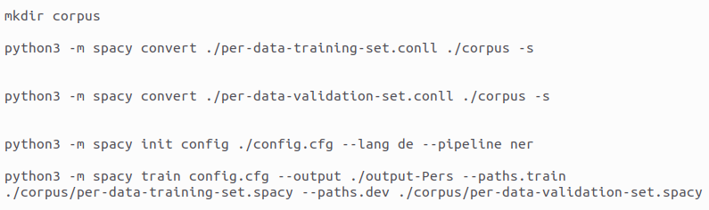
Custom and Pre-trained NER Model
Trained NER Model:
Using training and validation sets
Taking advantage of the spaCy training functionality to train model
Pre-trained Standard German Model:
spaCy large German pre-trained model [4]
Architecture: CNN

Slide 14
Evaluation Results
Model / Category | Trained NER Model |  |  | Standard German Model
 | Precision | Recall | F1-Score | Precision | Recall | F1-Score
B-PERS I-PERS | 0.89 0.92 | 0.85 0.82 | 0.87 0.87 | 0.62 0.89 | 0.56 0.48 | 0.59 0.62
B-LOC I-LOC | 0.73 0.37 | 0.53 0.11 | 0.61 0.17 | 0.34 0.14 | 0.69 0.20 | 0.46 0.17
B-ORG I-ORG | 0.81 0.83 | 0.65 0.67 | 0.72 0.74 | 0.11 0.21 | 0.05 0.05 | 0.07 0.07

Slide 15
Perspectives
Since our training data is relatively small:
Results imply that charters abstracts are too domain-specific to be handled easily by regular NER systems
Future Research:
Creating bigger charters abstracts dataset
Testing more cutting-edge models (BiLSTM-CRF, Embeddings)
Exploring fine-grained NER

Slide 16
References
[1] https://www.monasterium.net/mom/home
[2] https://www.monasterium.net/mom/AT-HHStA/SbgE/fond
[3] https://www.monasterium.net/mom/AT-StiAM/MelkOSB/fond
[4] https://spacy.io/models/de#de_core_news_lg
Aguilar, S.T., Tannier, X. and Chastang, P., 2016. Named entity recognition applied on a database of medieval latin charters. the case of chartae burgundiae. In 3rd International Workshop on Computational History (HistoInformatics 2016).
Chastang, P., Aguilar, S.T. and Tannier, X., 2021. A Named Entity Recognition Model for Medieval Latin Charters. Digital Humanities Quarterly, 15(4).
Aguilar, S.T. and Stutzmann, D., 2021, December. Named entity recognition for French medieval charters. In Proceedings of the Workshop on Natural Language Processing for Digital Humanities (pp. 37-46).

Slide 17
References
Aguilar, S.T., 2022, June. Multilingual Named Entity Recognition for Medieval Charters Using Stacked Embeddings and Bert-based Models. In Proceedings of the second workshop on language technologies for historical and ancient languages (pp. 119-128).
Monroc, C.B., Miret, B., Bonhomme, M.L. and Kermorvant, C., 2022, May. A comprehensive study of open-source libraries for named entity recognition on handwritten historical documents. In International Workshop on Document Analysis Systems (pp. 429-444). Cham: Springer International Publishing.
Boroş, E., Romero, V., Maarand, M., Zenklová, K., Křečková, J., Vidal, E., Stutzmann, D. and Kermorvant, C., 2020, September. A comparison of sequential and combined approaches for named entity recognition in a corpus of handwritten medieval charters. In 2020 17th International conference on frontiers in handwriting recognition (ICFHR) (pp. 79-84). IEEE.

